Slide 1
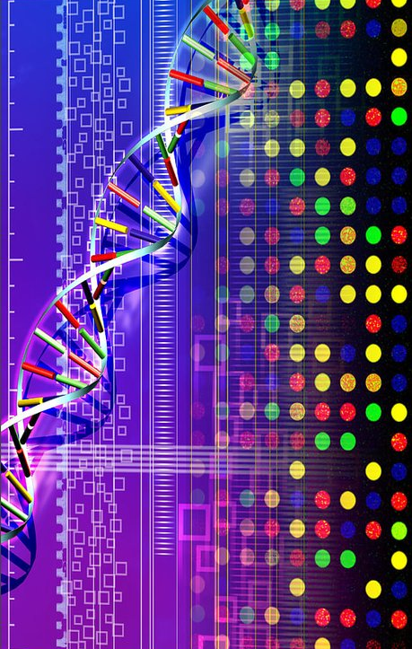
Microarray
DNA Microarray

Slide 2
MICRO ARRAY (BIOCHIPS)
A semiconductor device
It is used to detect the DNA makeup of a human cell.
Micro arrays contain millions of DNA strands designed to pair with their other half as the liquefied human cells are poured over them.
This "hybridization" process is then detectable by a laser.

Slide 3
MICRO ARRAY (BIOCHIPS)
Micro arrays are revolutionizing medicine by being able to pinpoint a very specific disease or the susceptibility to it.
Affymetrix (www.affymetrix.com) pioneered this technology with its GeneChip family.

Slide 4
Micro Array Features
The square locations on this Affymetrix array are called "features," and each feature holds millions of identical DNA strands called "probes." The probes are built like semiconductor chips, one layer at a time.

Slide 5
A Microarray can Identify Genes That are Transcribed

Slide 6
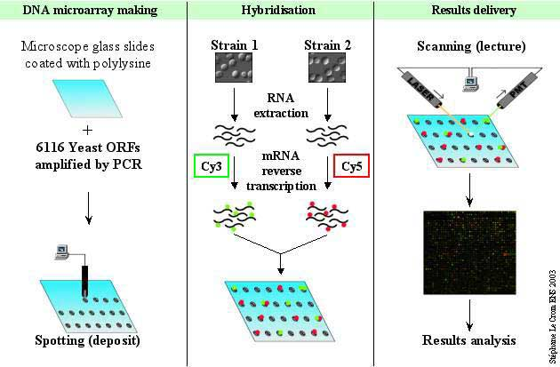

Slide 7
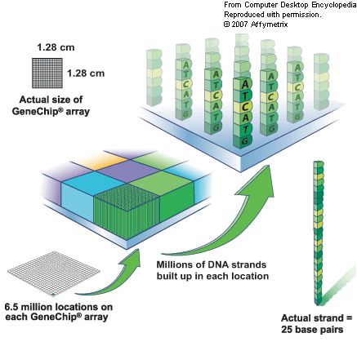

Slide 8
Hybridization (Pairing)
The human DNA sample, which has been replicated millions of times and fragmented into short pieces, is washed over the micro array. The red balls depict biotin molecules that were adhered to the fragments, which "swim" around the probes for up to 16 hours. During that time, some strands will pair with the probes (the hybridization process).

Slide 9
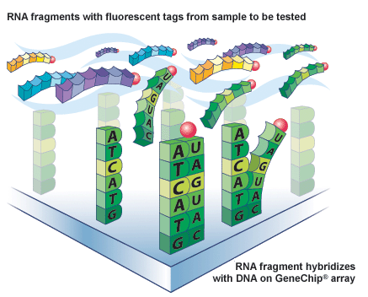

Slide 10
Detection
The array is rinsed and washed with a fluorescent stain that clings to the biotin on the strands of the human sample that remain. A laser causes them to glow, and the DNA is analyzed (genotyped) based on which probes on the array they mated with.

Slide 11
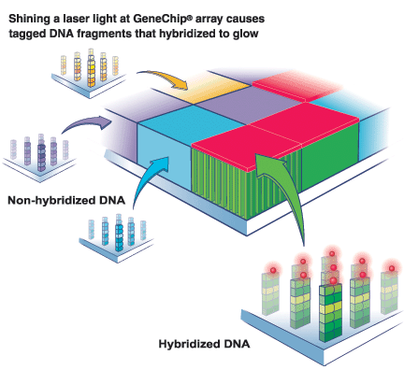

Slide 12
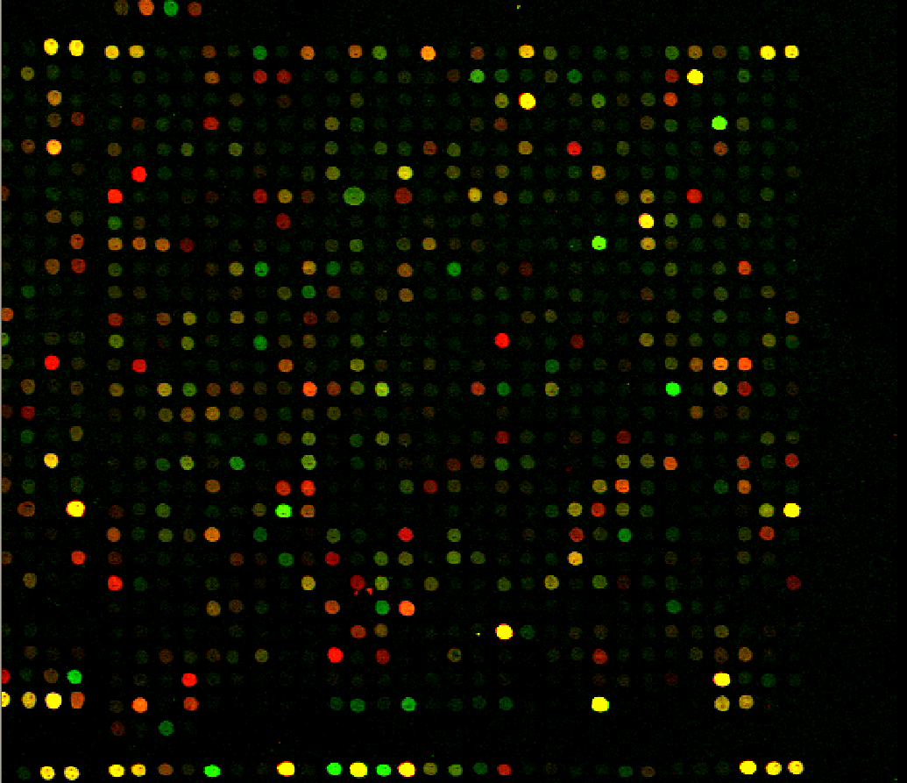

Slide 13
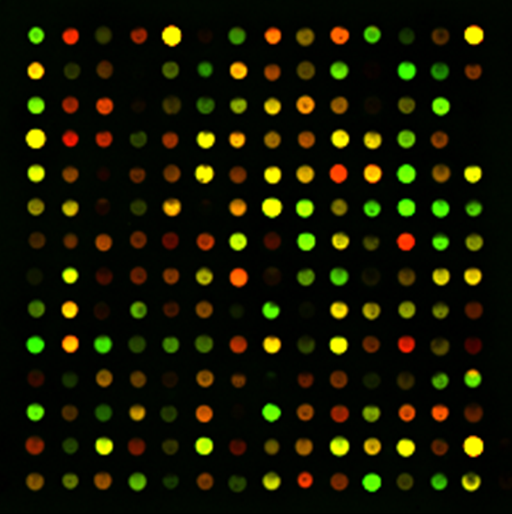

Slide 14
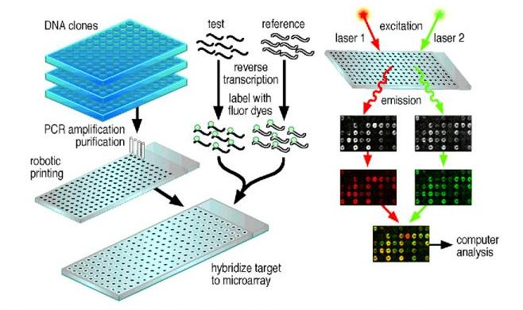

Slide 15
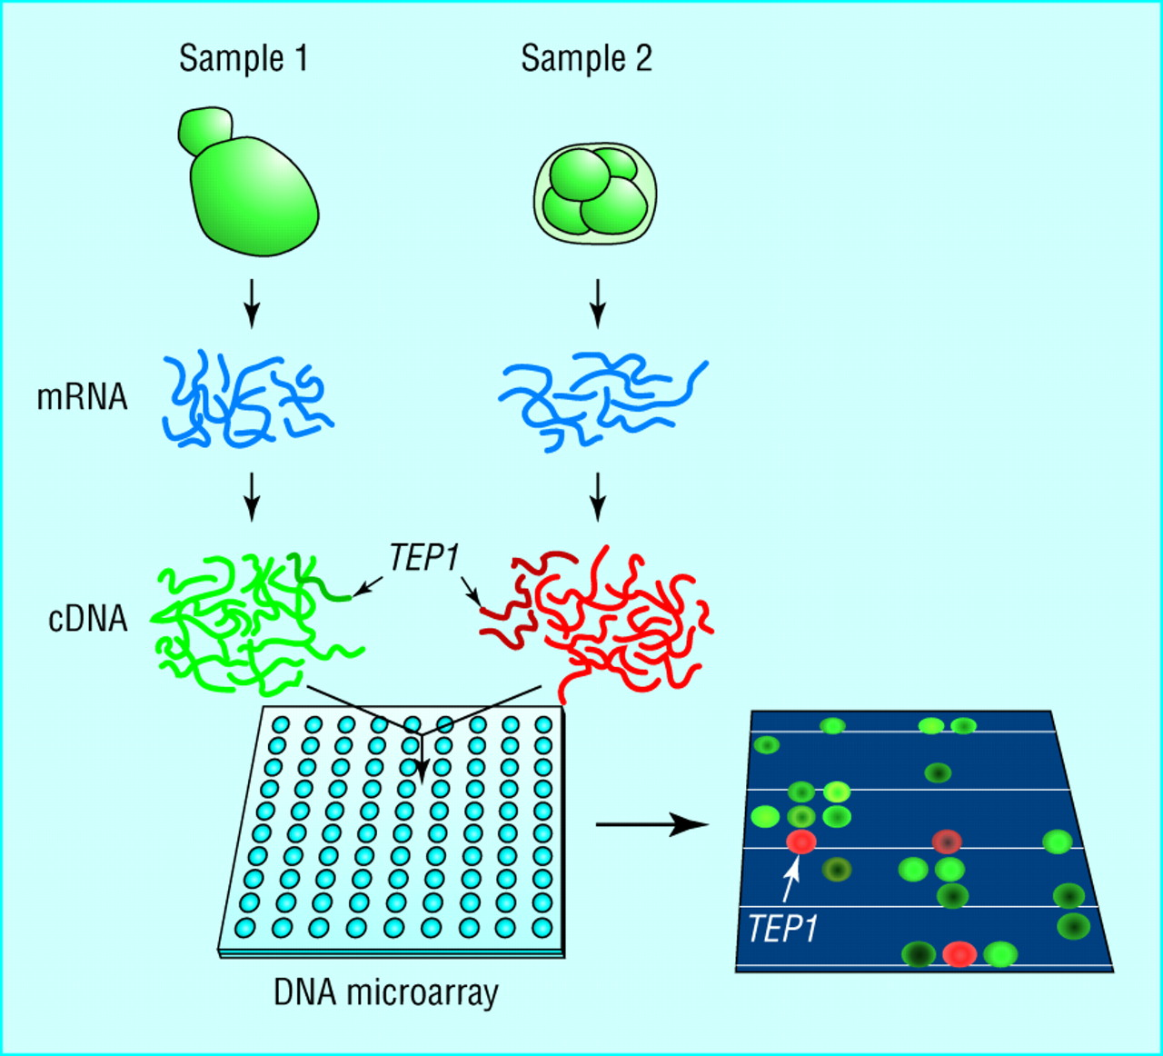

Slide 16
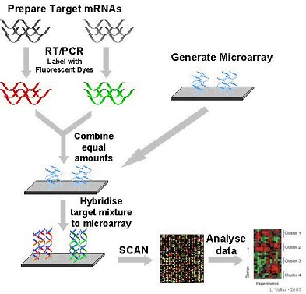

Slide 17
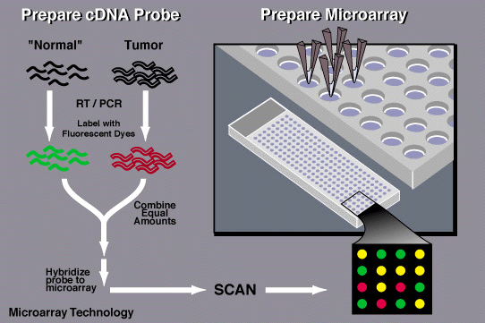

Slide 18
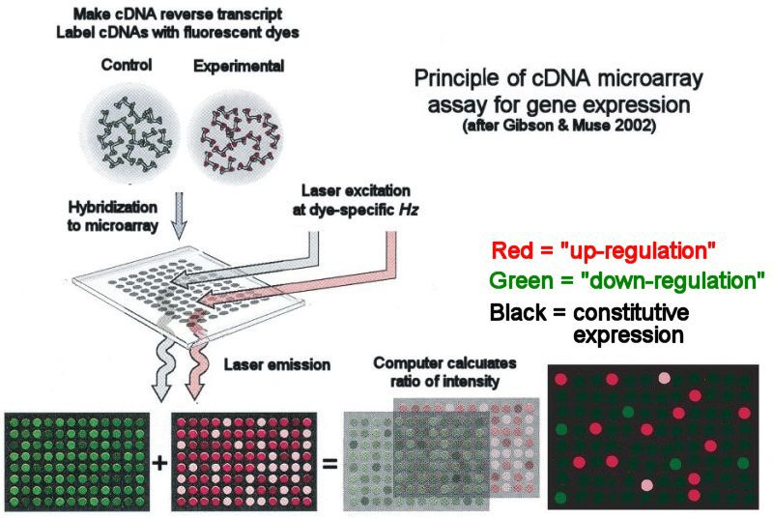

Slide 19
Cell-Specific Gene Expression
A comparison of microarray data using cDNAs derived from RNA of different cell types can identify genes that are expressed in a cell-specific manner

Slide 20
Gene regulation
Environmental conditions play an important role in gene regulation.
A comparison of microarray data may reveal genes that are induced under one set of conditions and repressed under another

Slide 21
Elucidation of Metabolic Pathways
Genes that encode proteins that participate in a common metabolic pathway are often expressed in a parallel manner. This can be revealed from a microarray analysis. This application overlaps with the study of gene regulation via microarrays.

Slide 22
Tumor Profiling
Different types of cancer cells exhibit striking differences in their profiles of gene expression. This can be revealed by a DNA microarray analysis. This approach is gaining widespread use as a method of subclassifying tumors that are sometimes morphologically indistinguishable. Tumor profiling may provide information that can improve a patient’s clinical treatment.

Slide 23
Genetic Variation
A mutant allele may not hybridize to a spot on a microarray as well as a wild-type allele.
Therefore, microarrays are gaining widespread use as a tool for detecting genetic variation.
They have been used to identify disease-causing alleles in humans and mutations that contribute to quantitative traits in plants and other species.
In addition, microarrays are used to detect chromosomal deletions and duplications.

Slide 24
Microbial Strain Identification
Microarrays can distinguish between closely related bacterial species and subspecies

Slide 25
DNA-Protein Binding
Chromatin immunoprecipitation, which is described in Figure, can be used with DNA microarrays to determine where in the genome a particular protein binds to the DNA.

Slide 26
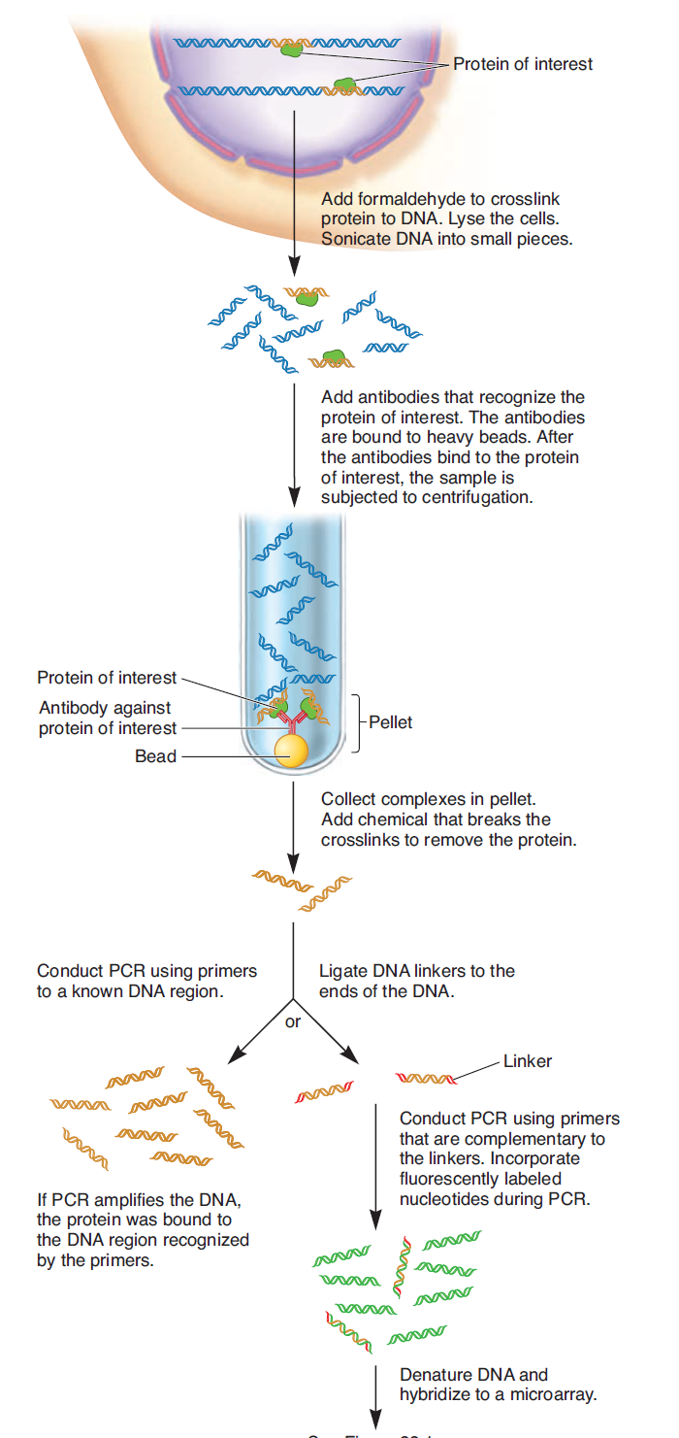

Slide 28
